Slide 1


Game Engines 6
Particle Physics
Dr Bryan Duggan
DIT School of Computing
bryan.duggan@dit.ie
@ditcomputing
http://facebook.com/ditschoolofcomputing

Slide 2
Remember!
a = F / m
v = v + a Δt
p = p + v Δt
This is known as a Forward Euler Integration function for a particle. Why?
Doesn’t take orientation into consideration
In the real world not all forces cause an acceleration
Some forces cause an angular acceleration
However, we can fake rotations

Slide 3
To fake rotations
Calculate a look vector from the velocity:
// Check if the velocity length is > epsilon and if so create the look vector from the velocity
if (glm::length(ship1->velocity) > epsilon)
{
ship1->look = glm::normalize(ship1->velocity);
}

Slide 4
And
Calculate a quaternion from the look vector:
// Now check to see if the |look - basis| > epsilon
// And if so calculate the quaternion
if (glm::length(ship1->look - GameComponent::basisLook) > epsilon)
{
glm::vec3 axis = glm::cross(GameComponent::basisLook, ship1->look);
axis = glm::normalize(axis);
float theta = glm::acos(glm::dot(ship1->look, GameComponent::basisLook));
ship1->orientation = glm::angleAxis(glm::degrees(theta), axis);
}

Slide 5
Particle Physics
Sometimes instead of modelling a complex object with many vertices, we need to model:
Lots of small objects each with a single vertex
This is called a particle system
We can also use these physics equations to model particles in a particle system!
Particles are used to simulate:
Smoke
Explosions
Zombie brains
Magic particles
Example

Slide 6
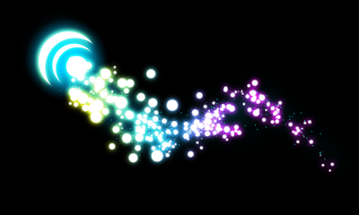

Slide 7
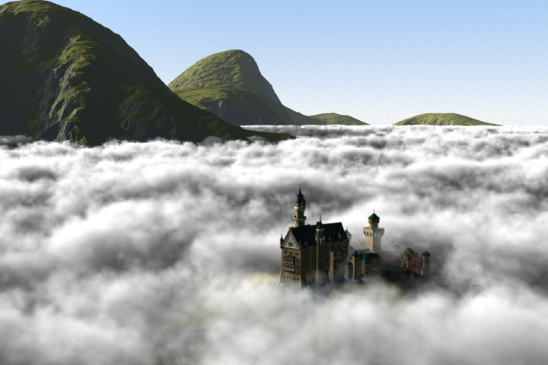

Slide 8
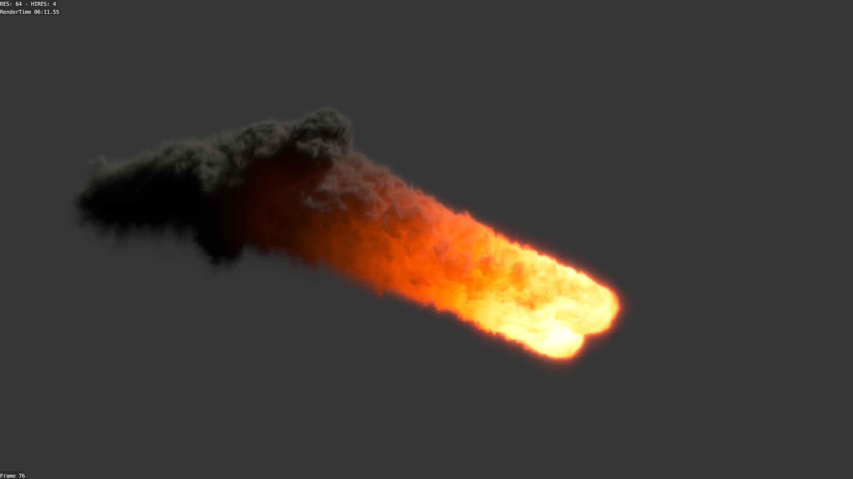

Slide 9
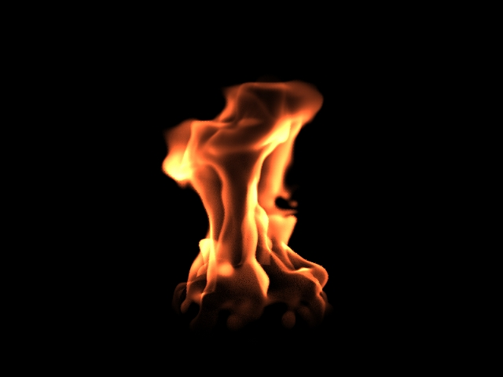

Slide 10
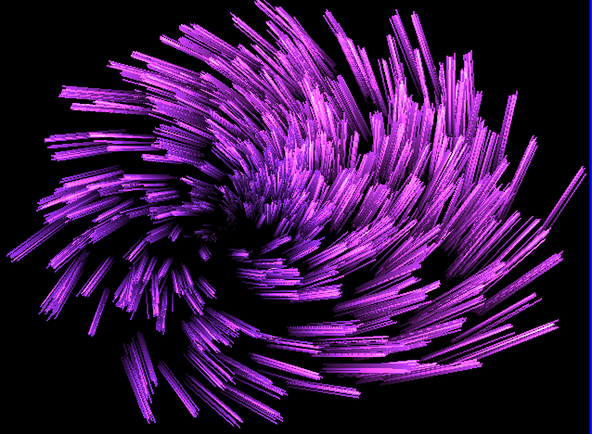

Slide 11
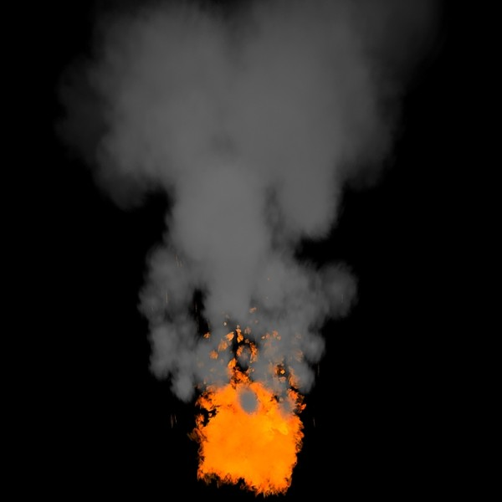

Slide 12
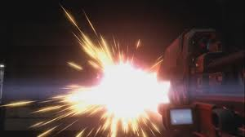

Slide 13
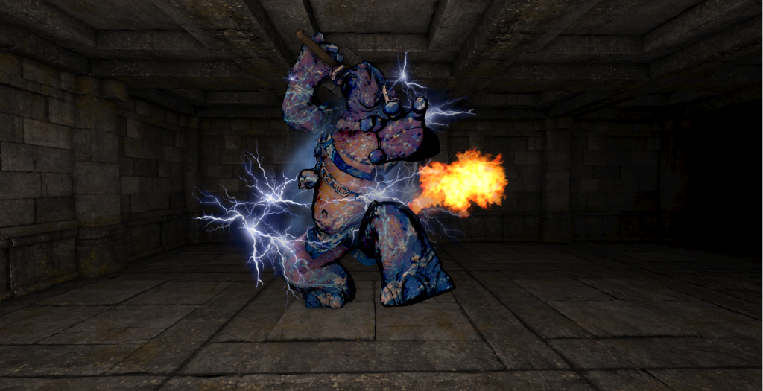

Slide 14
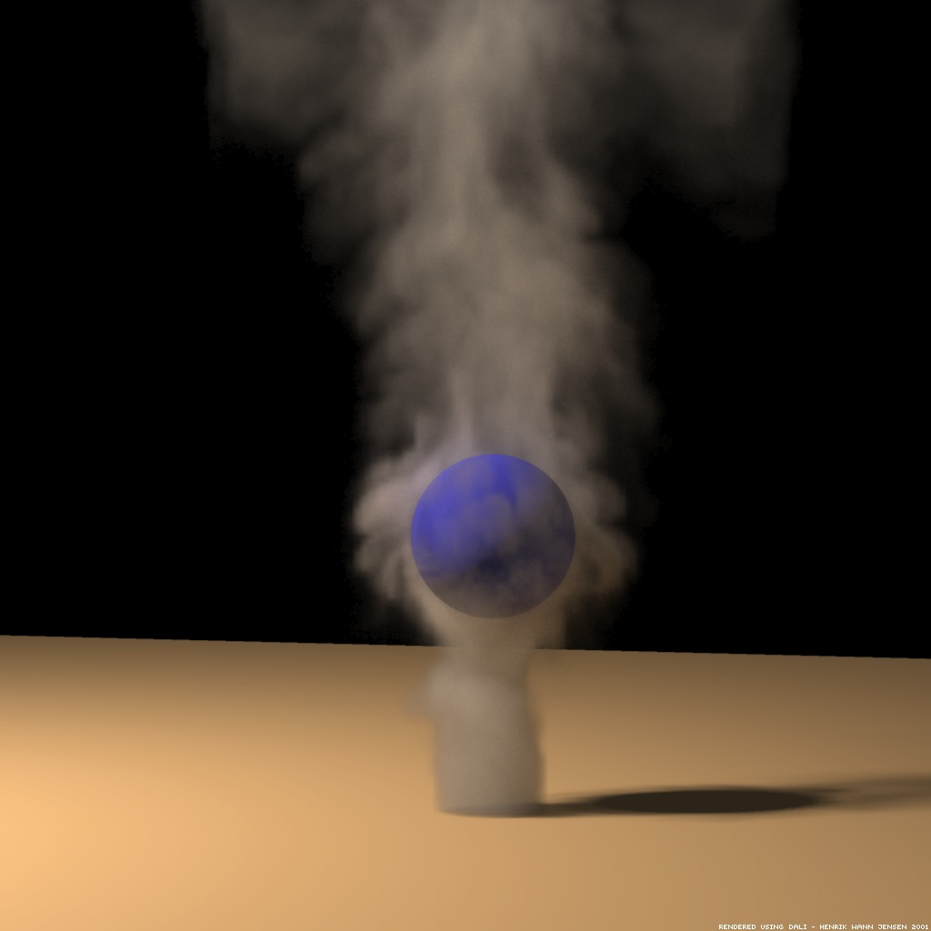

Slide 15
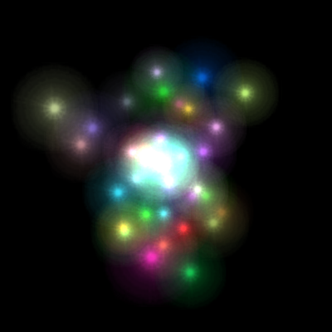

Slide 16
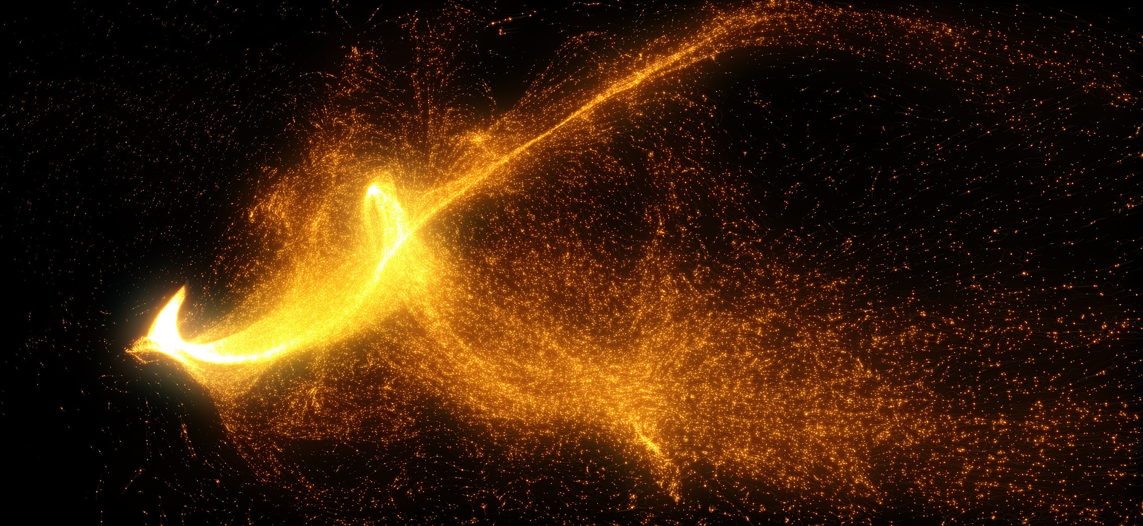

Slide 17
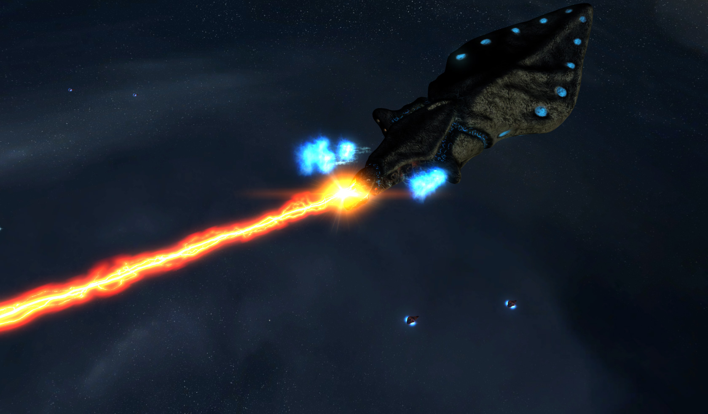

Slide 18
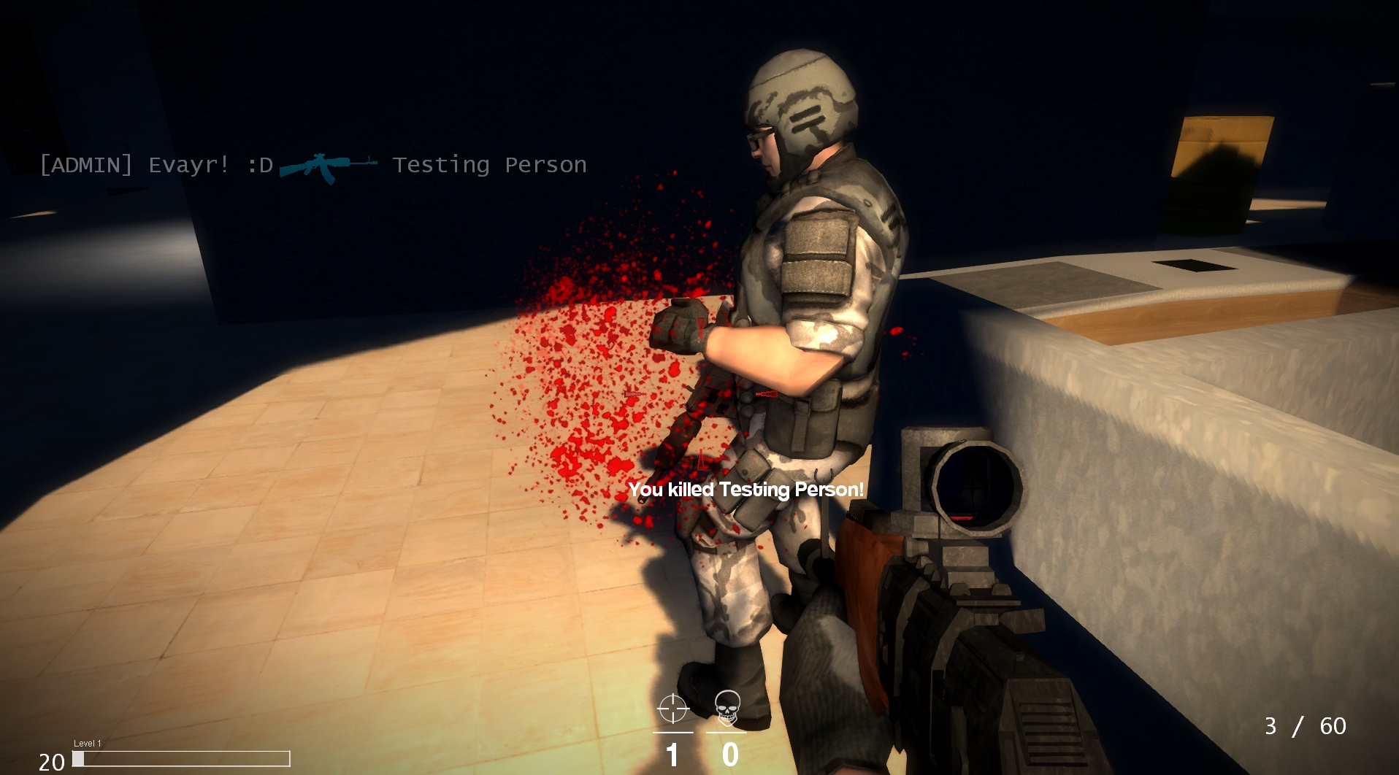

Slide 19
Requirements
Keep track of lots of particles
Create new particles (sometimes using random attributes)
Update each particle
Using the laws of physics
Render each one
When particles die, create new ones

Slide 20
Several approaches
Use point sprites
Instead of the vertex of a triangle…
Each vertex holds the position where a quad will be drawn
The quad is textured and can have a size
The quad always faces the camera
The quad is only drawn when the vertex is on the screen
Use quads
You specify the vertices of the quad
The quad is always drawn, but may be clipped
On the CPU
You update the state of each particle serially (possible using threads?)
Really limits the number of particles
This is what BGE does ☹
On the GPU
The particles get their state updated in the vertex shader…
Lots of articles about this on the net!
Probably not that difficult
http://relativity.net.au/gaming/java/ParticleSystem.html

Slide 21
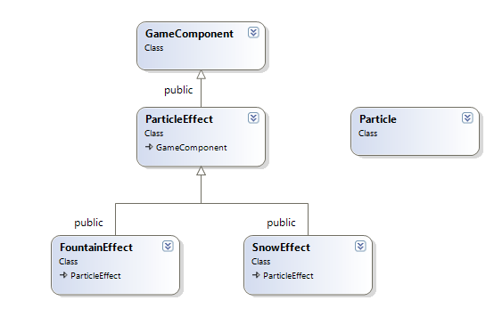
In BGE

Slide 22
ParticleEffect
bool Initialise();
void Update(float timeDelta);
void Draw();
virtual void InitParticle(Particle & particle) = 0;
virtual void UpdateParticle(float timeDelta, Particle & particle) = 0;
list<Particle> particles;
vector<glm::vec3> vertices;
vector<glm::vec4> colours;
vector<float> sizes;
Pure virtual functions! All subclasses must implement
These vectors will get passed into the shader

Slide 23
ParticleEffect
Initialise
Just loads the shaders and binds the VBO’s uniforms etc
Update(float timeDelta)
Iterates through the particles
Calls UpdateParticle for each one
Each particle that’s alive gets copied into the colours, vertices and sizes vectors
Draw
Just passes the colours, vertices and sizes vectors into the shader
Also passes in the world, view and projection matrices
Also binds the texture and sets up transparancy..

Slide 24
Particle
Does nothing.. just holds the state of a single particle
glm::vec3 position;
glm::vec3 velocity;
glm::vec4 diffuse;
float size;
float lifetime;
float age;
bool alive;

Slide 25
FountainEffect
A subclass of ParticleEffect
Emits particles that start at a central location and “spurt” upwards and outwards with random velocity
Are affected by gravity
When a particle reaches the ground, it respawns
Particle gets more transparent as it reaches the ground

Slide 26
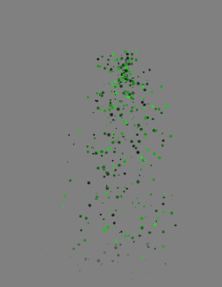
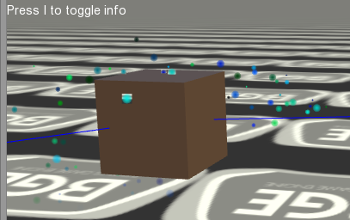

Slide 27
void FountainEffect::InitParticle(Particle & p)
{
float radius = 0.25f;
p.position = position; // Start the particle at the ParticleSystem position
// Give the particle a clamped random velocity
p.velocity = glm::vec3(RandomClamped(-radius, radius), RandomClamped(), RandomClamped(-radius, radius)) * 10.0f;
// Make the velocity always point upwards
p.velocity.y = glm::abs<float>(p.velocity.y);
// Give the particle a random colour
p.diffuse.r = diffuse.r * RandomClamped(0, 1);
p.diffuse.g = diffuse.g * RandomClamped(0, 1);
p.diffuse.b = diffuse.b * RandomClamped(0, 1);
p.age = 0;
p.alive = true;
// Random sizes also
p.size = RandomClamped(10, 50);
}

Slide 28
UpdateParticle
void FountainEffect::UpdateParticle(float timeDelta, Particle & p)
{
static glm::vec3 gravity = glm::vec3(0, -9.8, 0);
p.velocity += gravity * timeDelta;
p.position += p.velocity * timeDelta;
// Fade the alpha as we approach the ground
float fadeHeight = 5;
p.diffuse.a = glm::clamp<float>(p.position.y / fadeHeight, 0.0f, 1.0f);
if (p.position.y < 0)
{
InitParticle(p);
}
}

Slide 29
To use…
buddhaFountain0 = make_shared<FountainEffect>(500);
buddhaFountain0->position = glm::vec3(-30, 0, 0);
buddhaFountain0->diffuse = glm::vec3(1,1, 0);
Attach(buddhaFountain0);

Slide 30
SnowEffect
A subclass of ParticleEffect
Emits particles that start at a random X and Z location, but the same Y
When a particle reaches the ground, it respauns
Particle gets more transparent as it reaches the ground

Slide 31
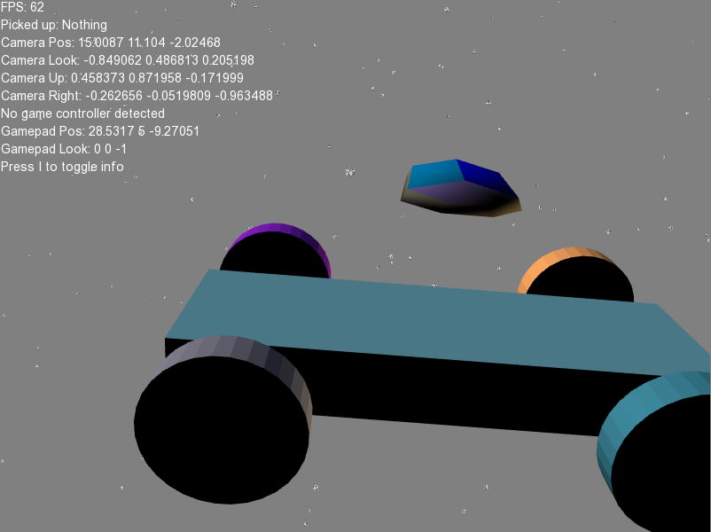
SnowEffect

Slide 32
InitParticle
float range = 1000.0f;
float radius = 0.1f;
// Give the particle a random X and Z, but fixed Y
p.position = glm::vec3(RandomClamped(-range, range), range, RandomClamped(-range, range));
// Give the particle a random down velocity
p.velocity = glm::vec3(RandomClamped(-radius, radius), RandomClamped(- radius, -radius * 5.0f), RandomClamped(-radius, radius));
// White colour
p.diffuse = glm::vec4(1,1,1,1);
p.age = 0;
p.alive = true;
p.size = RandomClamped(500, 600);

Slide 33
UpdateParticle
void SnowEffect::UpdateParticle(float timeDelta, Particle & p)
{
static glm::vec3 gravity = glm::vec3(0, -9.8, 0);
p.velocity += gravity * timeDelta;
p.position += p.velocity * timeDelta;
// Fade the alpha as we approach the ground
float fadeHeight = 20;
p.diffuse.a = glm::clamp<float>(p.position.y / fadeHeight, 0.0f, 1.0f);
if (p.position.y < 0)
{
InitParticle(p);
}
}

Slide 34
The vertex shader
The version of OpenGL
These are three arrays. The shader will run once for each element of the arrays. Each run of the shader will get an array element to process. The arrays are all the same size
Uniforms are values that don’t change between calls to the shader. In this case, the m, v and p matrices
The shader outputs a colour value
Calculate the VP matrix because the particles are already in world space
The position is the vertex position transformed by the VP matrices
We could just take the point size passed in, but better to scale the size based on distance from the camera
We can calculate the distance by transforming the vertex by the view matrix and getting the length, because in view space the camera is located at (0,0,0)
#version 330 core
layout (location = 0) in vec3 v_coord;
layout (location = 1) in vec4 v_diffuse;
layout (location = 2) in float point_size;
uniform mat4 m, v, p;
out vec4 colour;
void main(){
mat4 VP = p * v;
gl_Position = VP * vec4(v_coord,1);
colour = v_diffuse;
//gl_PointSize = point_size;
// Calculate the distance to the camera
vec4 eyePos = v * vec4(v_coord,1);
float dist = length(vec3(eyePos));
gl_PointSize = point_size * (8.0 / dist);
}

Slide 35
The fragment shader
#version 330 core
uniform sampler2D myTextureSampler;
in vec4 colour;
void main(void)
{
gl_FragColor = texture2D(myTextureSampler, gl_PointCoord) * colour;
}
Sample the texture and also multiply by the diffuse colour passed in by the vertex shader

Slide 36
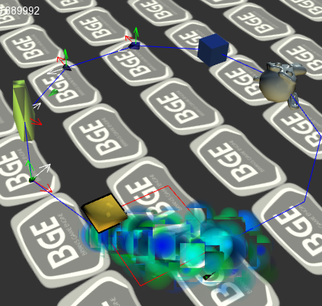
If you don’t scale size by distance from the camera…
Particles are always the same size…

